Slide 1
Parenthood as a Turning Point: Evidence from Social Media
Coauthor: Karthik Srinivasan (U Michigan)
&
Do People Know Who’s Happy?
Coauthors: Hannah Lybbert (U Chicago) and Justin Sydnor (U Wisconsin)
Devin Pope – August 15, 2026

Slide 2
Does parenthood change us?
“Motherhood has a very humanizing effect. Everything gets reduced to essentials.” – Meryl Streep
“Becoming a father changed my whole life. It taught me as if by revelation.” – Abraham Maslow
“There was the pre-kid me and the post-kid me” – Joe Rogan
“I am way more emotional… before kids, I was probably cold-hearted. But now? I’m a loving kind of fella.” – A$AP Rocky
“[Becoming a mother] has changed absolutely everything. It is such an incredible catalyst for growth. I found myself questioning absolutely everything: how I spend my time, how I speak, what kinds of projects I work on, and how I look at the world.” – Jennifer Connelly
“Becoming a father has changed me more than anything else in life.” – Prince Harry

Slide 3
An understudied topic?
Parenthood is likely to be one of the more impactful experiences that we have in life
Could change preferences
Could change incentives
Understanding the impact of parenthood is important in the context of declining fertility rates

Slide 4
An understudied topic? Cont.
The topic is generally difficult to study using laboratory methods. But some work in psychology nonetheless (often correlational evidence and mostly survey data):
Impact of parenthood on happiness and marital satisfaction – Twenge et al. (2003); Kahneman et al. (2005), Lucas et al (2003), Nelson et al. (2013), etc.
Having a baby can change your view of how dangerous the world is – Eibach, Libby, and Gilovich (2003)
Some other outcomes like impact of parenthood on sleep, physical well being, brain structure, etc.
The impact of parenthood as studied by economists:
Child penalties on wage inequality and career trajectories – Kleven et al. (2019, 2025), Lundborg et al. (2017)
We need more… how does parenthood affect consumption, political preferences, religiosity, risk-taking, social identity, etc.
Crime – Rose and Massenkoff (2024)
Notes:
Other options:
Psychology:
Blekesaune et al. (2022) - Religiosity increases when people become parents
Economics: (labor supply and income, gender inequality, credit access, educational attainment, social services take up, crime)
Lundberg (2000) – Birth of first child reduces mother’s wages and increases father’s wages
Lundborg et al. (2017) – Motherhood causes large, long-lasting drops in annual earnings
Adda (2017) –
LR effects of policies encouraging birth are smaller than SR estimates suggest
Earning penalty from children driven by reduced labor supply and selection into child-compatible occupations
Angelov (2016) – Income wage gaps have long term effects (32pp increase 15 years after first child birth)
Miller et al. (2023) – Women denied abortions experience persistent financial distress
Hotz et al. (1997) – Teen mothers earn and work more in later years than if childbearing had been delayed
Eichmeyer and Kent (2022) – Social services usage rises after having a child
Religiosity, voting, alcohol consumption, risk preferences, etc. (papers)?

Slide 5
Rose & Massenkoff (2024) – Mother’s (first birth)

Slide 6
Rose & Massenkoff (2024) – Father’s (first birth)

Slide 7
Rose & Massenkoff (2024) – Father’s (first birth)
Economic: theft/shoplifting, burglary, forgery; Drugs: illegal drug possession, providing liquor to minors; Destruction: vandalism, property damage

Slide 8
Social media as a source of data
It can be hard to find data with exact dates of birth paired with interesting behavior/outcomes.
We scan Twitter and Reddit and flag birth announcements (sample: ~7,000 Twitter and ~22,000 Reddit announcements).
We can look into the life of these new parents by how and what they post about leading up to and after birth.
Research Questions
How does parenthood impact posting frequency? Does it differ for mothers vs. fathers?
Do the topics that someone posts about change after having a child?
How does overall sentiment (e.g. positivity) of posts change after becoming a parent?

Slide 9
Outline of talk
Introduction
Twitter
Data collection
Posting frequency
Topics
Sentiment analysis
Reddit
Early findings

Slide 10
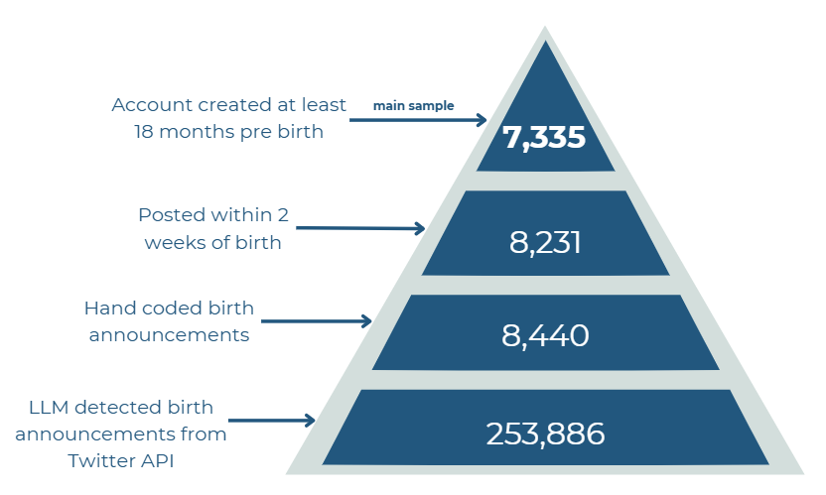
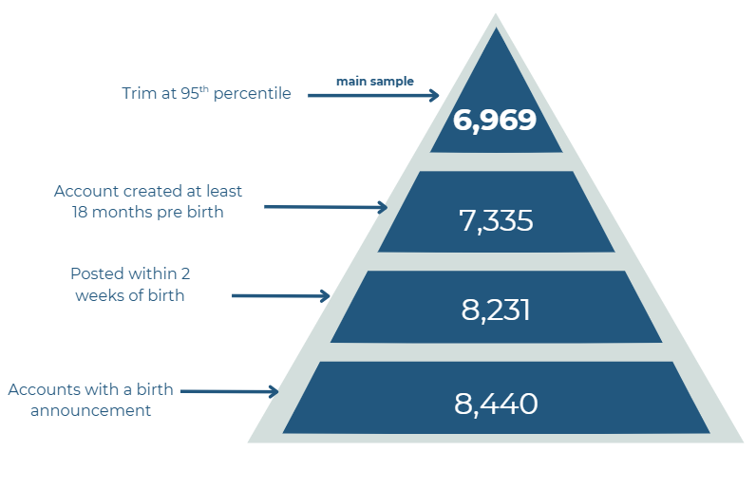
Twitter data collection
Notes:
Do you want more of a breakdown of HOW we got these data? Or do you just want to talk through it?
Twitter API pull aided by LLM to pull on certain criteria
Hand coders came in an whittled it down a bunch
Restricted to the announcement having been within 2 weeks pre/post birth
Account must have been created at least 18 months pre birth to ensure full possible pre trend data
Note: I don’t include on here that we actually trim at the 95th percentile, that gets our actual sample down to 6,969. I can make that adjustment easy if you’d like! (would also need to change the number on slide 8)

Slide 11
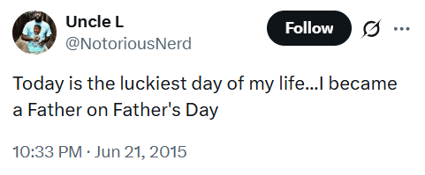
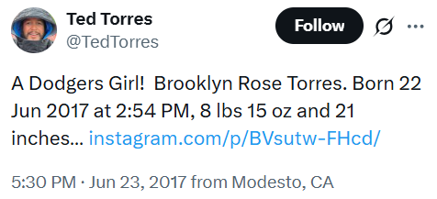
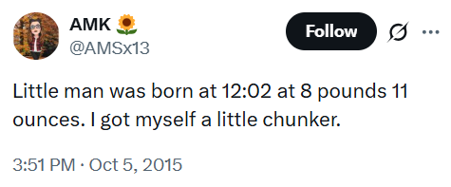
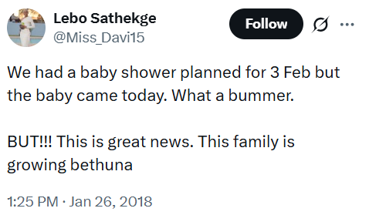
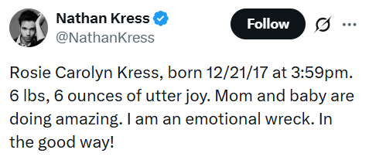
Examples of birth announcements on Twitter

Slide 12
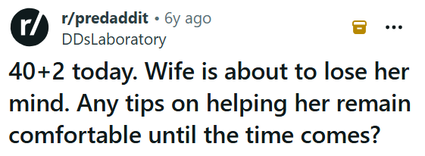
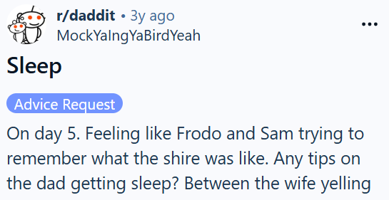
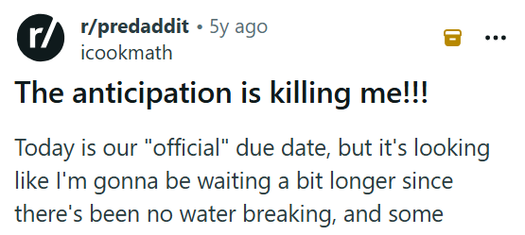
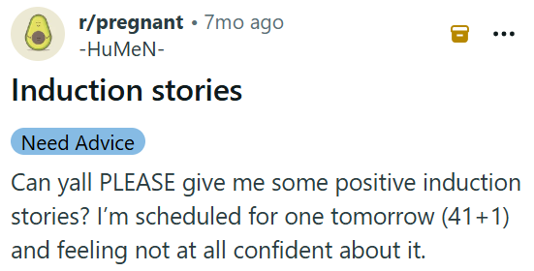
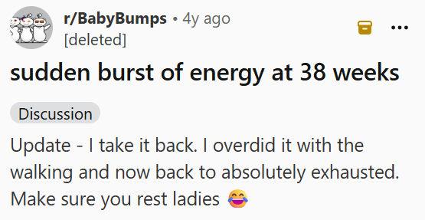
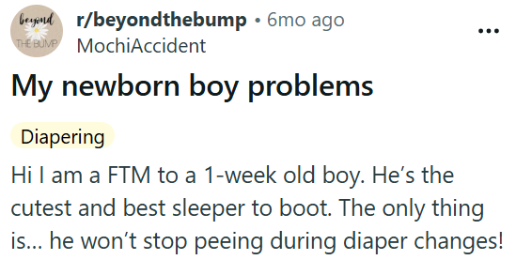
Examples of birth announcements on Reddit

Slide 13
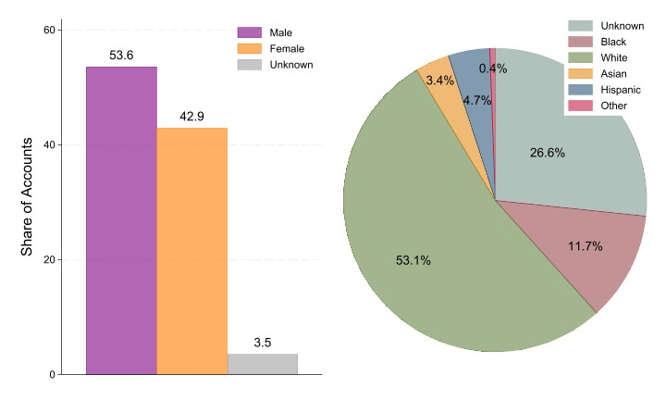
Gender and Race Distributions
Notes:
If you want different colors, let me know. It’s an easy fix!
Note: we exclude “unknown” gender from this plot, just the male/female split. If you want unknown as well I can add that in!

Slide 14
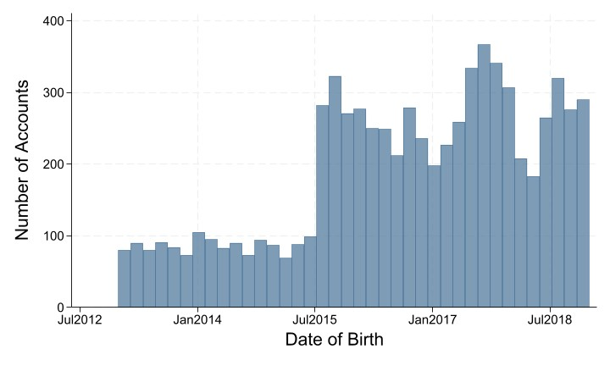
Birth Dates Distribution

Slide 15
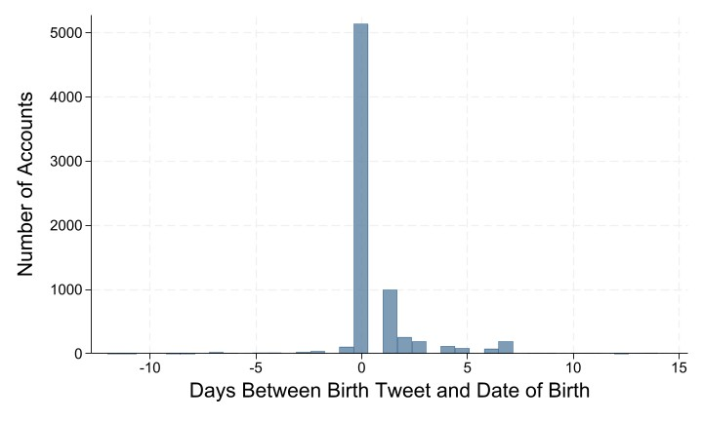
Days From Birth Distribution
Notes:
Negative = pre birth, positive = post birth

Slide 16
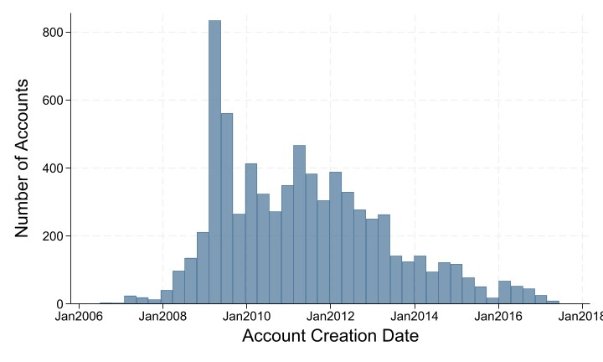
Distribution of Twitter Account Creation Dates

Slide 17
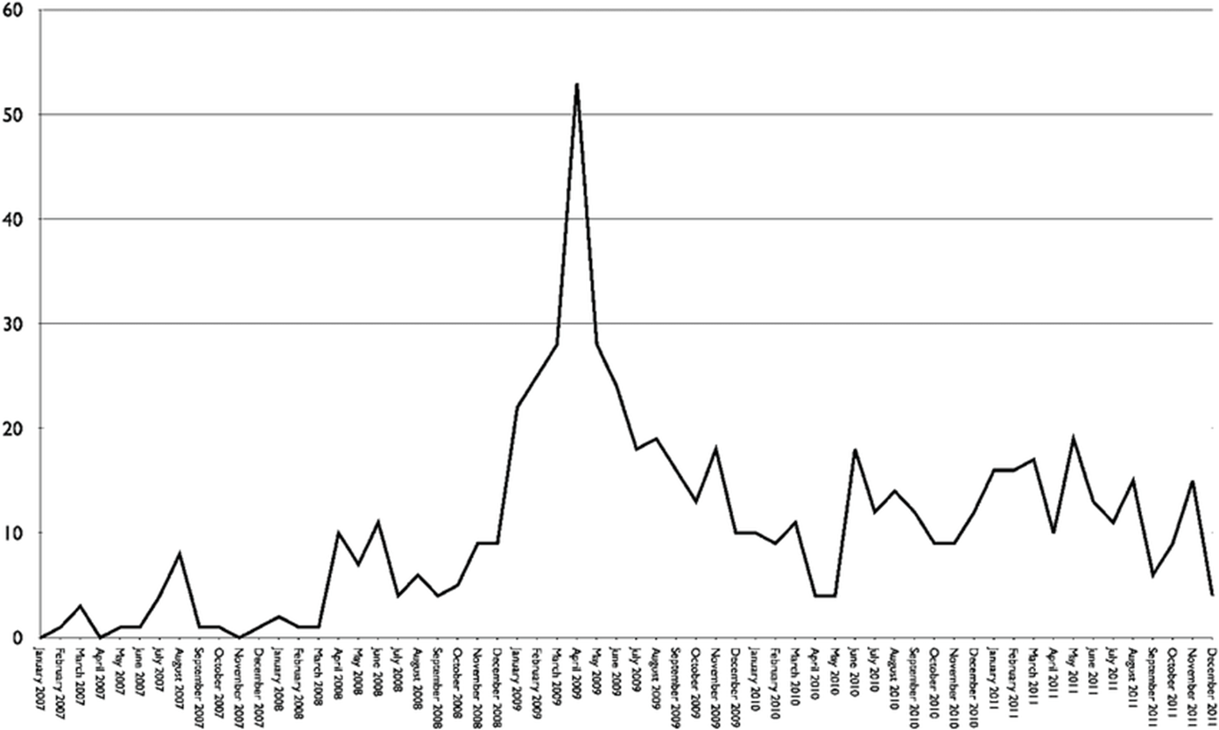
Distribution of Twitter Account Creation Dates
Notes:
Lulic, Ileana & Kovic, Ivor. (2012). Analysis of emergency physicians' Twitter accounts. Emergency medicine journal : EMJ. 30. 10.1136/emermed-2012-201132.

Slide 18
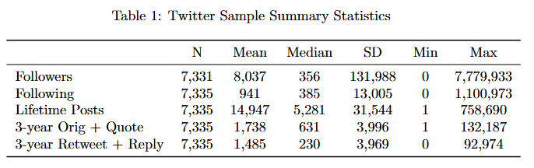
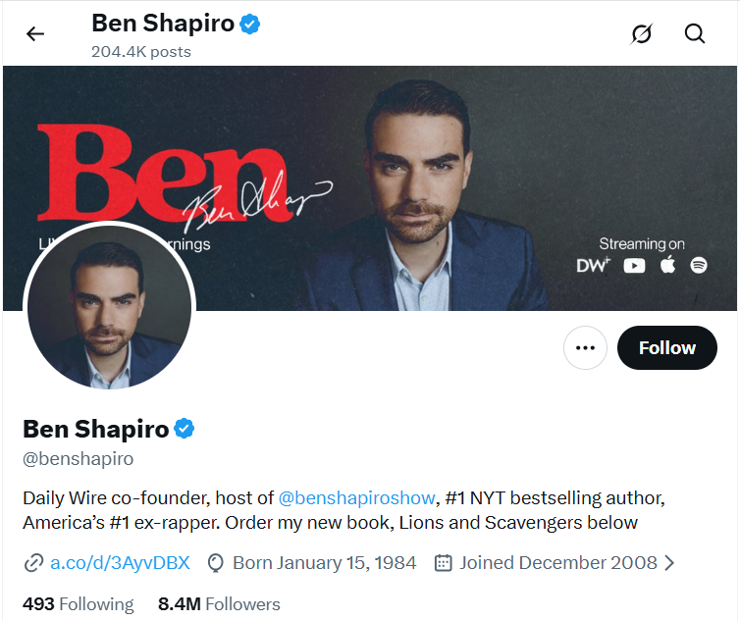
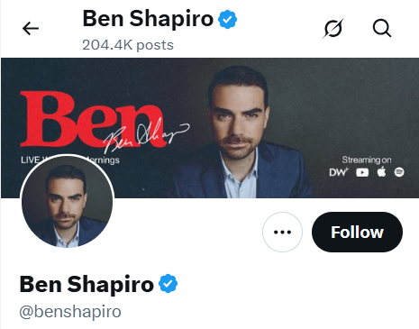
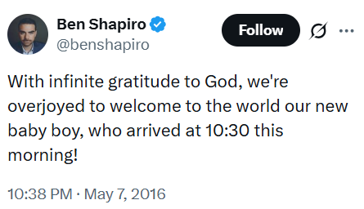
Account-Level Features
Notes:
Ben Shapiro is the one with 7.7M followers

Slide 19
Outline of talk
Introduction
Twitter
Data collection
Posting frequency
Topics
Sentiment analysis
Reddit
Early findings
Conclusion

Slide 20
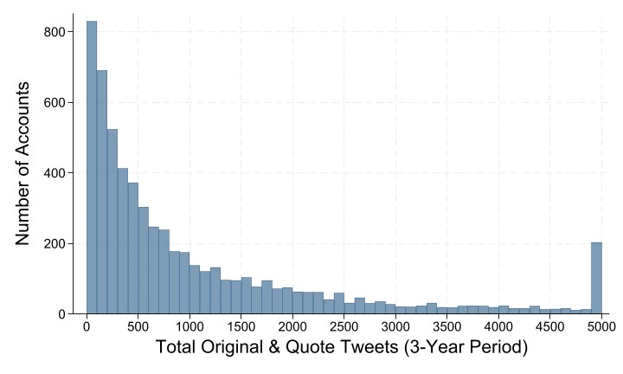
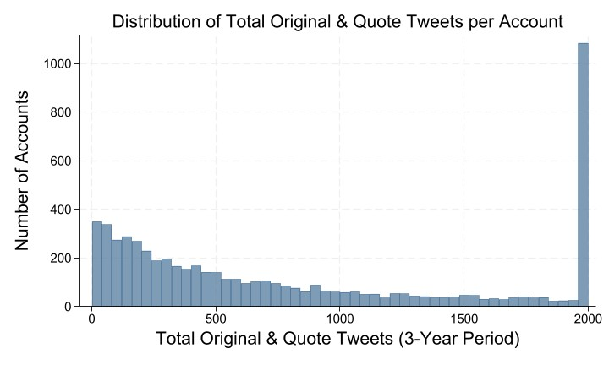
Distribution of original + quote
Notes:
You had said to lump into a 2000 bin but that created a super sharp right tail. Cut at 5000 instead but can easily swap back. Also note the figure is just original and quote tweets (not retweet+reply because that would decrease our sample so I kept it just og_qt as you suggested)

Slide 21
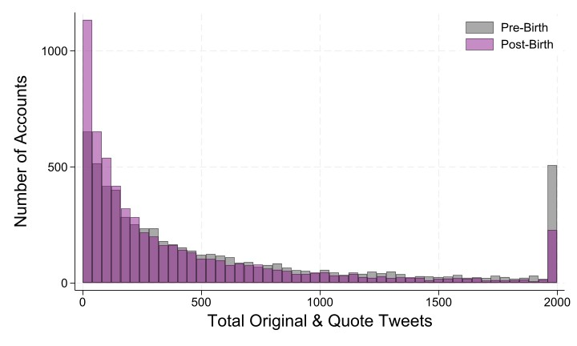
Distribution of original + quote – pre/post
Notes:
Note: I lump this one at 2000 instead of 5000 just because It would have been a longer tail if I kept it at 5000. If you’d rather it be at 5000, the image is on the right

Slide 22
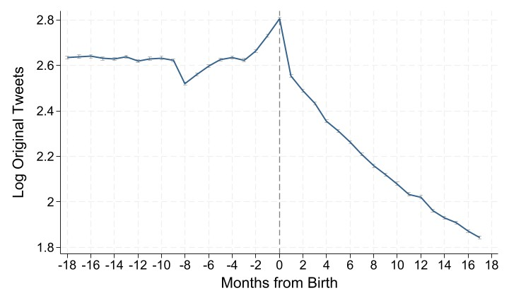
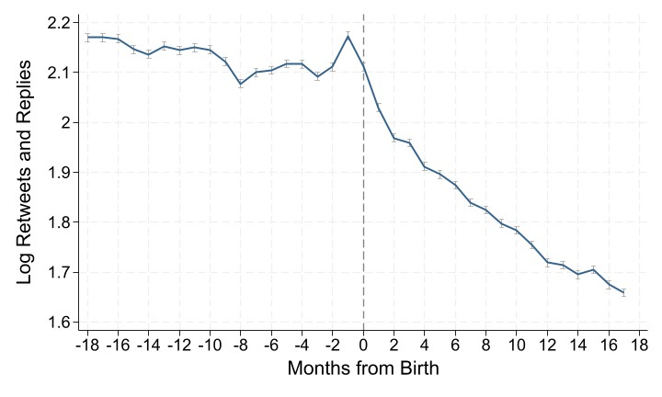
Log original tweet frequency
~60% decrease
Notes:
How I computed the decrease:
1.85-2.65 = -0.8
E^(-0.8) = 0.415 (new level is ~41.5% of old level)
→ 58.5% decrease

Slide 23
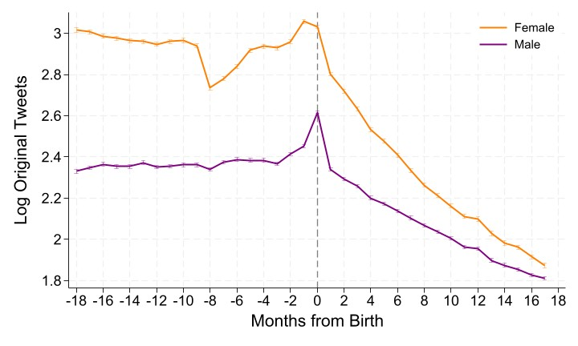
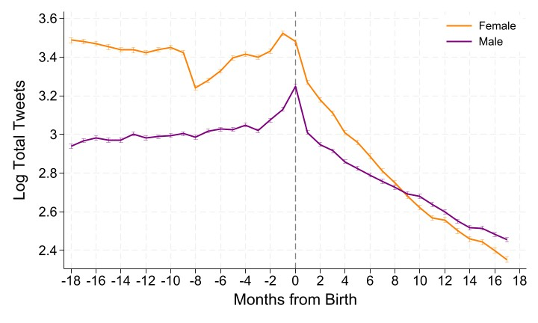
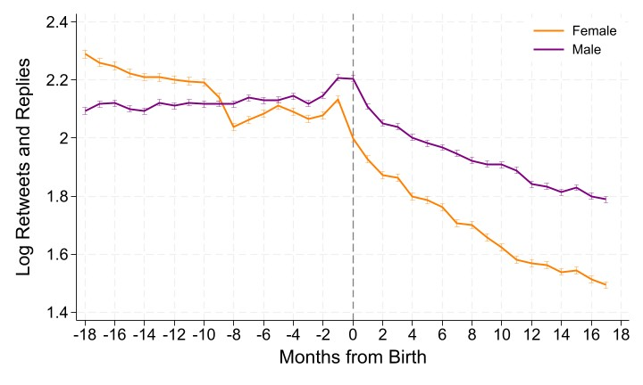
Log original tweet frequency – by gender
~70% decrease
~40% decrease

Slide 24
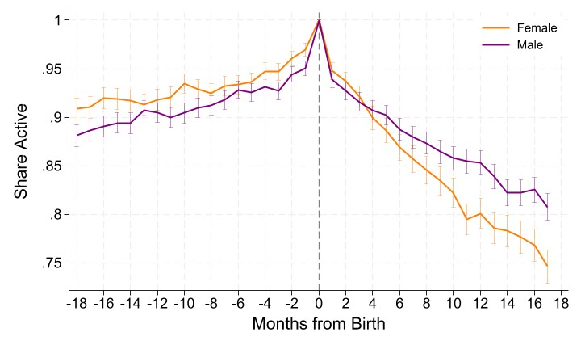
Extensive Margin – by gender

Slide 25
Outline of talk
Introduction
Twitter
Data collection
Posting frequency
Topics
Sentiment analysis
Reddit
Early findings
Conclusion

Slide 26
Topic Analysis
What are people tweeting about?
Method:
Pre-trained AI NLP model (RoBERTa) trained specifically on tweets
Scores every tweet with a probability across 19 categories
  Family, sports, food, etc.
Notes:
NLP = natural language processing
RoBERTa = robustly optimized BERT Pretraining Approach
BERT = bidirectional encoder representations from transformers.
Open source transformer-based language model
Pretty much an approach that allows contextualized understanding of words for natural language processing
Method:
Remove birth announcement tweet + any family-related tweets (prevents the model from "cheating")
Strip year numbers from text (prevents using the calendar as a shortcut)
“family related” = probability the tweet was a family tweet was >20%
TF-IDF vectorization = essentially a scoring system that measures how uniquely important
each word or two-word phrase is to a given person's pre/post period.

Slide 27
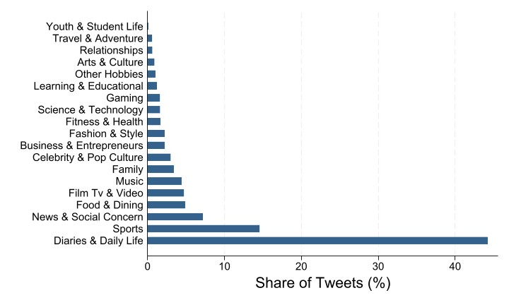
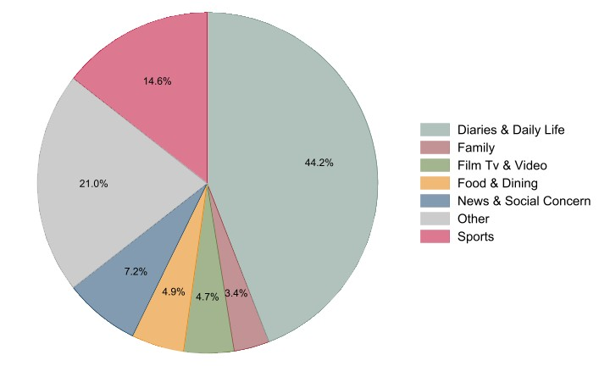
Topic Category Shares
Notes:
Pie is top 5 categories + family and then all other categories are grouped into “other”

Slide 28
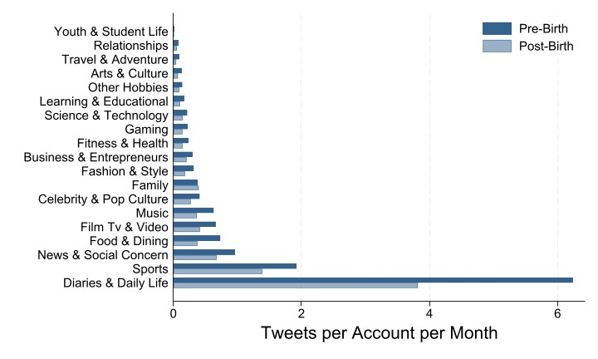

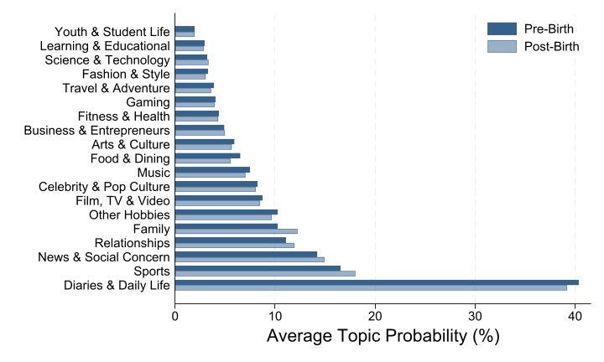
Topic Shares (by account per month)
Notes:
Tweets per account per month not pre post
Average probability of tweets being assigned to a given topic

Slide 29
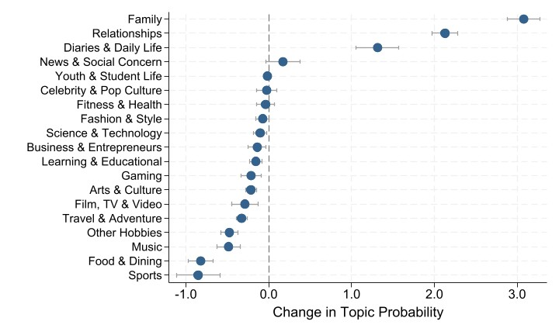
Change in tweet topics

Slide 30
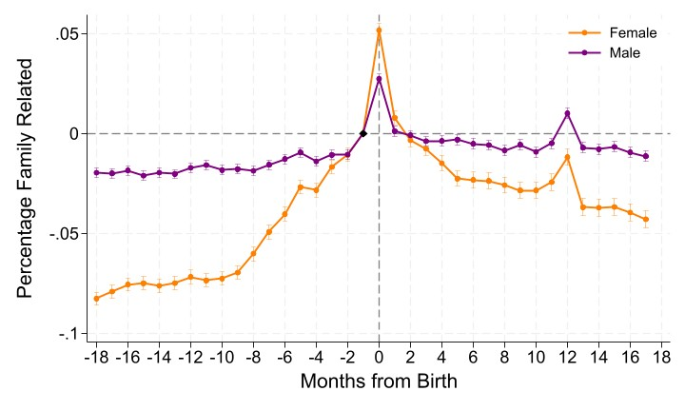
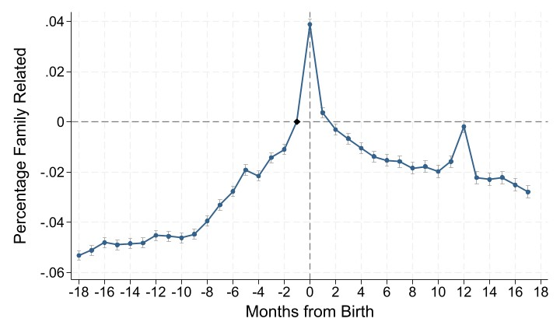
Probability of family tweet – by gender (FEs)

Slide 31
Outline of talk
Introduction
Twitter
Data collection
Posting frequency
Topics
Sentiment analysis
Reddit
Early findings
Conclusion

Slide 32
Sentiment Analysis
What is the emotional tone of a user’s tweets?
Method:
Using the same pre-trained AI NLP model (RoBERTa), each tweet is scored on its positive, negative, and neutral sentiment (range of 0- for each).
Final sentiment score = positive – negative (ranges from -1 to 1)
Scores aggregated to the author level pre- and post-birth

Slide 33
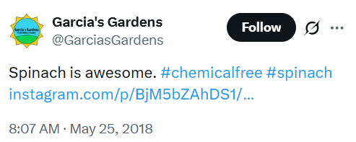
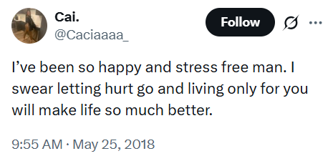
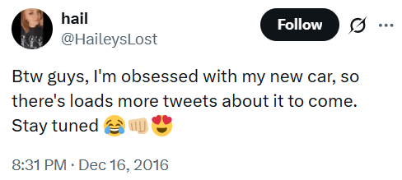
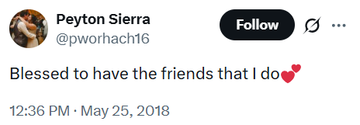
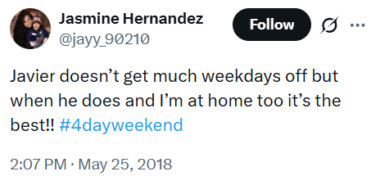
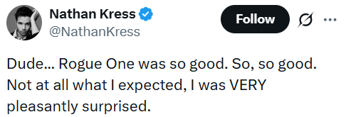
Positive Tweets
Notes:
>= 0.99 sentiment score

Slide 34
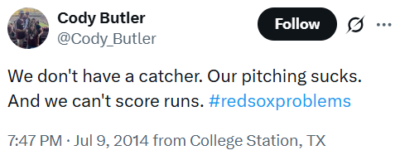
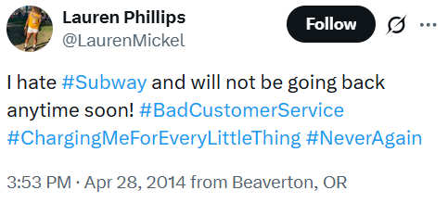
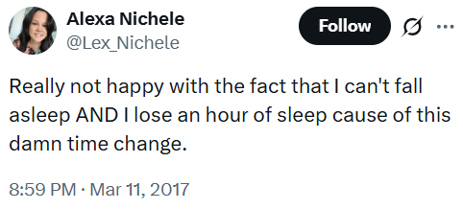
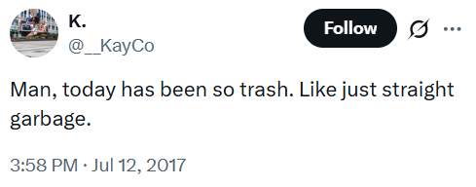
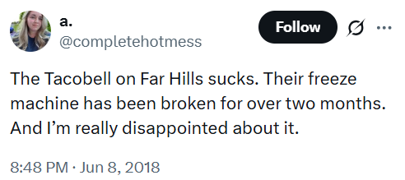
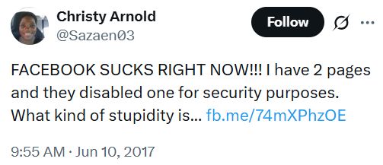

Negative Tweets
Notes:
>= 0.99 sentiment score

Slide 35






Neutral Tweets

Slide 36

Distribution of average tweet sentiment
Notes:
Colors are a little hard to see the difference, could change but that would change the prepost figures for all the other bar charts!

Slide 37

Tweet positivity – by gender (author FE)

Slide 38

Tweet negativity – by gender (author FE)

Slide 39
Outline of talk
Introduction
Twitter
Data collection
Posting frequency
Topics
Sentiment analysis
Reddit
Early findings
Conclusion

Slide 40

Reddit data collection
Notes:
From Reddit data, collected all posts posted to 13 birth/pregnancy related subreddits
Ran all of those posts through Open AI models to classify each post as a “birth post” or not.
Double run process: GPT-4o-mini model to initially classify and whittle down sample, then ran positive birth instances through GPT-4o model to get more precision
Must have explicit timing indicators (ex. 39+2, 1 week PP, “in labor”, “induced today”
days from birth (based on timing indicators, and only -28 to 28 range)
Gender probability (0-100 probability the poster is male/female)
Note: we have not used hand coders here, but based on hand checking a sample of 100 positive instances, 94% are confirmed true positives → high precision classifier
Restricted DOB to be before July 1, 2023 to ensure 18 months of potential post birth posting history (to avoid inevitable drop off if birth was at the end of the sample), and trimmed lifetime posters with >99th percentile
Note: We didn’t trim at the 95th percentile because most of our sample accounts were legitimate as they passed through a pretty rigorous LLM classification process, but there will still a couple of outliers remaining so trimmed at 99th
Restricted to accounts who posted at least 18 months before birth so we have a full pre sample period.
Note: this is a pretty strict cut off because most people start on Reddit by commenting not posting. More accounts were likely active by the 18 month mark but just had not posted by then. Once Karthik gets comment history and account level details (ex. Account creation date), our sample shouldn’t drop off so much at this restriction.

Slide 41

Gender Distributions
Notes:
Note: we exclude “unknown” gender from this plot, just the male/female split. If you want unknown as well I can add that in!

Slide 42

Top Birth Subreddits

Slide 43


Birth Dates Distribution
Notes:
Figure on the side is from an article online. Just showing that this increase we see in birth “announcements” on Reddit corresponds to reddit usage/popularity over the years
Link here: https://seo.ai/blog/how-many-users-does-reddit-have

Slide 44

Days from Birth Distribution

Slide 45

Distribution of Reddit Posts
Notes:
Binned at 200

Slide 46

Distribution of Reddit Posts – pre/post birth
Notes:
Binned at 200

Slide 47

Log posting frequency
~14% decrease

Slide 48

Log posting frequency – by gender
~13% decrease
~11% decrease

Slide 49
Conclusion
The transition to parenthood is a detectable signal in social media data
Mothers reduce posting frequency by 67%; fathers by 42%
Both men and women show measurable linguistic shifts post-birth
  Posts shift toward more family-centered topics
  Sentiment becomes slightly more positive
Preliminary Reddit results show similar trends with smaller magnitude
Notes:
Parenthood changes social media use
Men and women both reduce posting frequency (42% vs 67% decrease)
Topics during pregnancy and post birth are more about family
Posts become slightly more positive
So far reddit results look similar

Slide 51














Notes:
One click per book and headline = 12 clicks

Slide 52
Notes:
One click to make all the headlines appear at once

Slide 53
Do People Know Who’s Happy?
Biased Beliefs
Large research literature in economics showing that people’s beliefs can be biased (Brunnermeier & Parker 2005; Bordalo et al. 2016; Bénabou & Tirole 2016; Bursztyn & Yang 2022)
People might make choices based on inaccurate beliefs from stereotypes and projection rather than observation
Those beliefs feed into major life choices and into public narratives about who is thriving or struggling that shape policy and voting behavior
Biased in a systematic way?
“Grass is Greener”: other’s lives look better than they are
Motivated Reasoning: my own group looks better than it is
Stereotyping: right direction, exaggerated gaps
Notes:
Papers being sited right now:
Optimal Expectations, AER (Markus Brunnermeier, Jonathan Parker, 2005)
https://www.aeaweb.org/articles?id=10.1257/0002828054825493
Stereotypes, QJE (Pedro Bordalo , Katherine Coffman , Nicola Gennaioli , Andrei Shleifer, 2016)
https://academic.oup.com/qje/article/131/4/1753/2468882
Mindful Economics: The Production, Consumption, and Value of Beliefs, JEP (Roland Bénabou and Jean Tirole, 2016)
https://www.aeaweb.org/articles?id=10.1257/jep.30.3.141
Misperceptions About Others, Annual Review of Econ (Leo Bursztyn and David Yang, 2022)
https://www.annualreviews.org/content/journals/10.1146/annurev-economics-051520-023322

Slide 54
Ground Truth
General Social Survey
2004 – 2024
Sample size = 28,889
Weighted using GSS survey weights
Happiness question: Taken all together, how would you say things are these days -- would you say that you are very happy, pretty happy, or not too happy?
1 = not too happy; 2 = pretty happy; 3 = very happy
National average = 2.11

Slide 55
Ground truth - Groups
We chose 14 characteristics to study.
  General demographic questions + items often discussed in the happiness literature
  Available in GSS
Sex
Age
Race
Education
Income
Marital status
Children ever born
Religious attendance
Political party
Town type
Physical health
Socialization
Sexual orientation
Region of U.S.

Slide 56
Prediction Survey
Prolific
Sample size = 1,944 (dropped 53 due to failed attention checks)
Asked respondents to not look up the answer:
  Important: Happiness levels for different groups are available in public data, and AI tools could also generate these estimates. We're not testing your ability to look up the right answer — we want to know what you intuitively think. Please answer using your own knowledge and best guess, without searching the internet or using AI tools.
Survey has 3 parts:
Own happiness: exact GSS question, 3-point scale
Predict the average happiness for 44 subgroups across 14 dimensions
14 demographic questions, matching the GSS variables
Notes:
Prolific sample restricted to:
US residents
Fluent in English
Taken at least 20 prolific surveys
Prolific rating of 99%+
2,033 Prolific responses
33 were not “approved” by prolific
2 were detected as bots by prolific
53 failed an attention check (pet dying, work promotion, and click count == 0)
1 duplicate author

Slide 57


Slide 58


Slide 59


Slide 60


Slide 61

Ground Truth

Slide 62


Slide 63


Slide 64


Slide 65


Slide 66


Slide 67


Slide 68

Notes:
Democrats think republicans are happier (grass is greener)
Republicans think republicans are happier (motivated reasoning)

Slide 69

Notes:
Motivated reasoning through and through
Married think married are happier
Non married think non married are happier

Slide 70

Notes:
Big city think small town is happier (grass is greener)
Small city think small city happier (motivated reasoning)

Slide 71

Notes:
Grass is greener for women.
Women think men are happier
Men think men and women are about the same happiness

Slide 72
Conclusion
People believe their choices are the happy ones.
  Chosen characteristics (marriage, kids, religion) tend to be biased by motivated reasoning
Innate characteristics (ex. Sex, age, race) tend to result in a “grass is greener” effect, rating the other group as happier
Next steps:
Does accuracy differ between happier and less happy respondents?
Is the own-group perception effect moderated by respondent’s own happiness?
Notes:
Except we also see grass is greener with where people live (big/small town)

Slide 73
Thank You!

Slide 74
Happiness - Appendix
Notes:
Parenthood changes social media use
Men and women both reduce posting frequency (42% vs 67% decrease)
Topics during pregnancy and post birth are more about family
Posts become slightly more positive
So far reddit results look similar

Slide 75
Betas plot

Slide 76


Slide 77


Slide 78


Slide 79
Happy vs unhappy predictions

Slide 80


Slide 81


Slide 82


Slide 83


Slide 84


Slide 85


Slide 86
Respondent vs GSS Average Happiness

Slide 87


Slide 90
Survey descriptives & Respondent Demographics

Slide 91


Slide 98
Online Regulation
Examples of online regulation
China’s broad censorship regime
Platform restrictions (Tiktok in India, Twitter/X in Brazil, etc.)
Social media restrictions for kids in Australia
Sports gambling across U.S. States
Challenges of online regulation
Noncompliance by firms (e.g. Off-shore companies)
Circumvention by consumers (e.g. Virtual Private Networks)
Substitution from compliant to noncompliant platforms
Notes:
Parenthood changes social media use
Men and women both reduce posting frequency (42% vs 67% decrease)
Topics during pregnancy and post birth are more about family
Posts become slightly more positive
So far reddit results look similar

Slide 99
Regulation of Adult Websites
Huge online adult website industry
4 of the top 20 most visited websites worldwide are adult websites
The top 5 adult websites generated 8.9B visits (more than any other individual website except Google and Youtube)
Single men on average self-report spending 2+ hours on adult sites per week.
More than 50% of children under the age of 13 have viewed online pornography
Age verification laws
Started with Louisiana in January 2023 (25 additional states since)
In response, Pornhub (largest online adult website) chose to shutdown in 25 states (for both adults and children)
Alternative large sites (e.g. XNXX, Xvideos) did not comply with the law
Consumers can circumvent law by using VPNs
Notes:
Parenthood changes social media use
Men and women both reduce posting frequency (42% vs 67% decrease)
Topics during pregnancy and post birth are more about family
Posts become slightly more positive
So far reddit results look similar

Slide 100


Slide 101
Research Question
What are the behavioral responses to age-verification laws?
For every 100 hours spent on adult websites prior to a state passing an age verification law, what happens to those hours post law:
Noncompliance: hours that continue unabated because website did not comply
Circumvention: hours spent on a compliant website due to VPN use
Substitution: hours that shifted from compliant to noncompliant sites
Cessation: hours that disappear from adult websites
Notes:
Parenthood changes social media use
Men and women both reduce posting frequency (42% vs 67% decrease)
Topics during pregnancy and post birth are more about family
Posts become slightly more positive
So far reddit results look similar

Slide 102
Data
Comscore
Individual-level online activity data for a rotating sample of ~550,000
Includes mobile and desktop devices for Jan 2022 to Dec 2024
Stable geographic identifier (allows us to assign browsing to the machine’s location even when VPN is being used)
We do NOT track incognito or private browser activity
We are tracking adults (not kids)
Primary outcome variable
Weekly minutes spent on Pornhub, alternative sites, and all XXX sites combined
Notes:
Parenthood changes social media use
Men and women both reduce posting frequency (42% vs 67% decrease)
Topics during pregnancy and post birth are more about family
Posts become slightly more positive
So far reddit results look similar

Slide 103
Time spent in the pre-treatment period
All XXX: 6.3 minutes weekly minutes/device
Compliant sites
Pornhub: 1.4 minutes
Chaterbate: .3 minutes
Xhamster: .3 min
RedTube: .1 min
YouPorn: .1 min
Spankbang: .1 min
Camsoda: .1 min
Non-Compliant sites
XVideos: 1.0 minutes
XNXX: 0.8 minutes
200k+ more: 2.1 minutes
Notes:
Parenthood changes social media use
Men and women both reduce posting frequency (42% vs 67% decrease)
Topics during pregnancy and post birth are more about family
Posts become slightly more positive
So far reddit results look similar

Slide 104


Slide 105


Slide 110


Slide 111
Summary of Results
For every 100 hours spent on adult websites prior to a state passing an age verification law, what happens to those hours post law:
Noncompliance: 65 hours
Circumvention: 19 hours
Substitution: 8 hours
Cessation: 8 hours
Policymakers should be interested in the breakdown above when thinking about how to make regulations more impactful
Notes:
Parenthood changes social media use
Men and women both reduce posting frequency (42% vs 67% decrease)
Topics during pregnancy and post birth are more about family
Posts become slightly more positive
So far reddit results look similar

Slide 112
Conclusion
Online regulation can be difficult due to noncompliance and circumvention
We provide evidence of how firms and consumers respond to age verification laws for adult websites
The majority of time spent on adult websites continues unabated due to compliance, circumvention, and substitution. 8% of viewing disappears.
Notes:
Parenthood changes social media use
Men and women both reduce posting frequency (42% vs 67% decrease)
Topics during pregnancy and post birth are more about family
Posts become slightly more positive
So far reddit results look similar

Slide 113
Thank You!

